Slide 1
New Product Overview
January 2022

Slide 2
New Wireless

Slide 3
1135 Wireless Siren
Annunciates carbon monoxide alarms with distinct Temporal 4 cadence
Quickly identifies the emergency so users don’t confuse with fire alarms
Siren is compliant with ANSI/UL 985 household fire warning system

Slide 4
New Com Series

Slide 5
DualCom FirstNet
Approved for use on the only nationwide, high-speed wireless public safety network to serve all customers
Engineered with dual tip and ring terminals for commercial fire communication, working elegantly with existing FACPs
Band 14 delivers robust coverage compared to any commercial wireless network
Upgrades old system to LTE. As phone lines drop out, easily connect to older panels with dialer communicators only

Slide 6
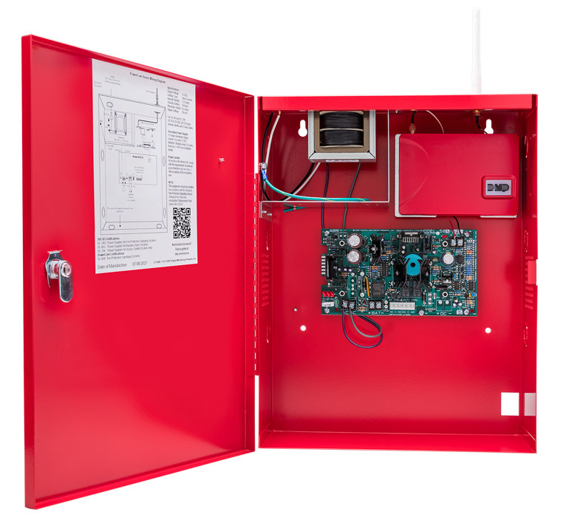
PowerCom Fire
No need to resubmit battery calculations when upgrading an existing system
Self-powered packaged solution with a regulated, power limited, switching power supply
Meets UL, CSFM, NFPA, FCC and FDNY compliance standards
Comes pre-assembled in one enclosure to easily upgrade existing fire panels

Slide 7
New
Access Control Features

Slide 8
X1 Version 214
Auto-Unlock Suppress — keeps doors locked until a valid user arrives — despite bad weather or personnel delays, your business will always remain secure
Manager First option — eliminates concerns over employees being in the workplace without supervision
When you need to unlock doors for a specific event or a temporary timeframe, Temporary Schedules allow you to modify a regular schedule based on a specified beginning and ending time and date
Displayed DHCP Network Information — At a glance, you’ll always know what IP address you’re using, making for quicker troubleshooting

Slide 9
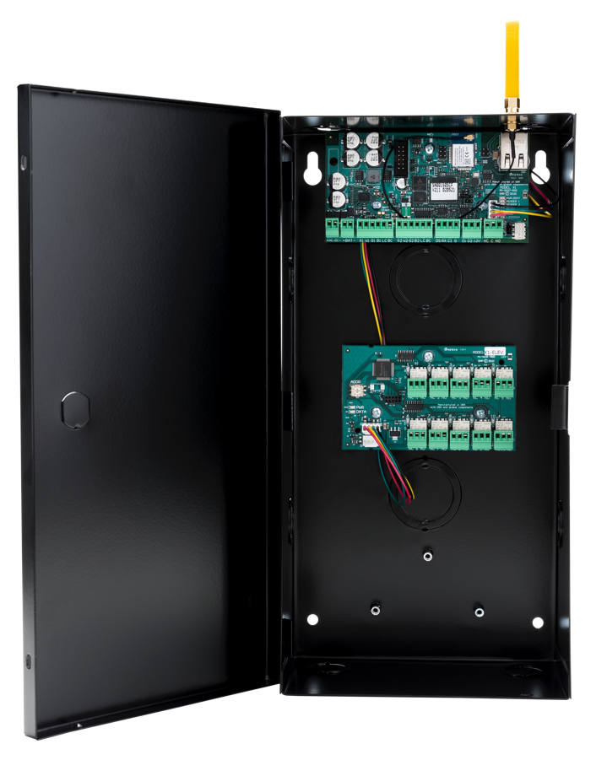
X1 Elevator Control
Network communication with optional cellular primary or backup communication
Optional PoE add-on module for powering the board and attached door equipment
Support for one door with two readers (in and out), a door position switch, a request to exit and a customizable input
When enhanced security is requested, the X1 supports OSDP, as well as Wiegand on any or all readers

Slide 10
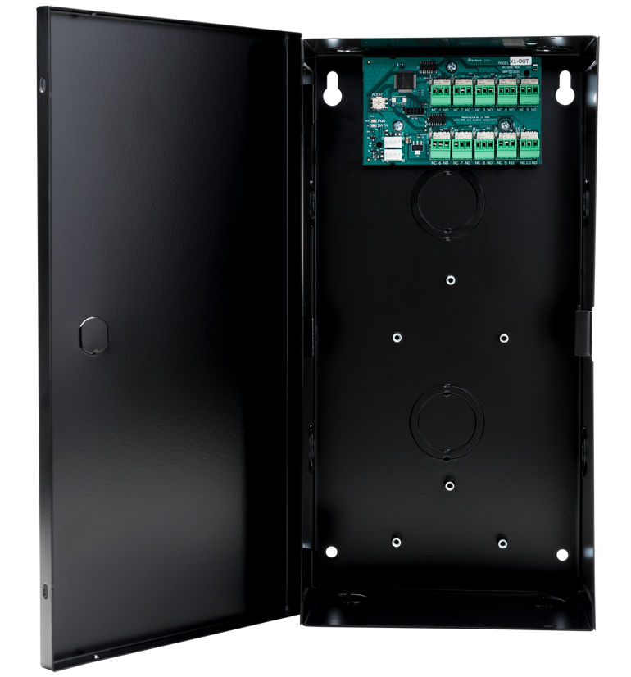
X1 Output Expansion Module
Access denied at the front door can trigger the NVR or video camera to record a video clip
The first access granted can trigger the Building Management System to turn on lights or activate an HVAC schedule
A non-access control door with an electric strike can be unlocked from a reception button
A door propped on the back door turns on an LED light at the front gate guard station

Slide 11
New
Video Integrations

Slide 12
Hanwha WAVE Integration
View all Hanwha cameras, video playback and manage your security system, all with Virtual Keypad
Allows dealers to log into a Hanwha WAVE account withing Virtual Keypad app
This integration delivers an easy-to-use fully featured IP video management software solution with onboard analytics

Slide 13
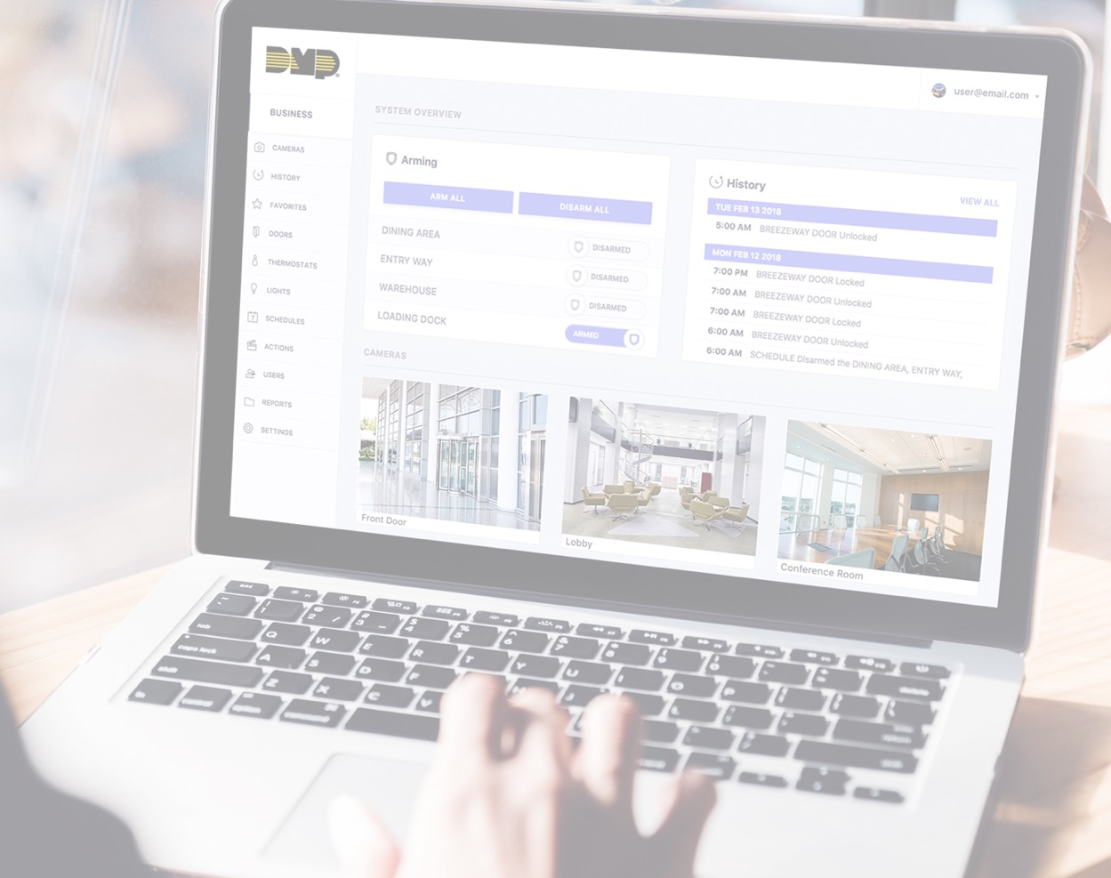
New Virtual Keypad App Features

Slide 14
CSV Import for the X1 Series
Support in Virtual Keypad makes it easy to import hundreds of credentials and their users all at once, as quickly as you can add just one
No hand-entering individual users and their permissions
Simply migrate a large database of users from an existing system and import them all into the X1 Series
Can also add multiple credential to one user

Slide 15
New Dealer Admin Features

Slide 16
Central Station Integration
Technicians can place systems on and off test without a single call to the monitoring center
Users can also place their systems on and off test and update their emergency contact lists
Fewer routine calls to the monitoring center means greater efficiency in handling the workload without needing more operators
Available at no cost to all Dealer Admin account holders

Slide 17
Two-Factor Authentication
Adds an additional layer of security against cyberattacks for all Dealer Admin and Virtual Keypad accounts
Users must enter a security code they receive via text or email to successfully log in
Second form of authorization ensures the person trying to log in is who they say they are
Locks down access to Dealer Admin and Virtual Keypad accounts so you and your customers can take full advantage of managing security remotely

Slide 18
Remote Link Updates
All Remote Link updates are now downloadable straight from Dealer Admin
Download the latest software versions, organized in one convenient place with one login and password for added security
No need to manage your legacy login and password to access DMP’s old website

Slide 19
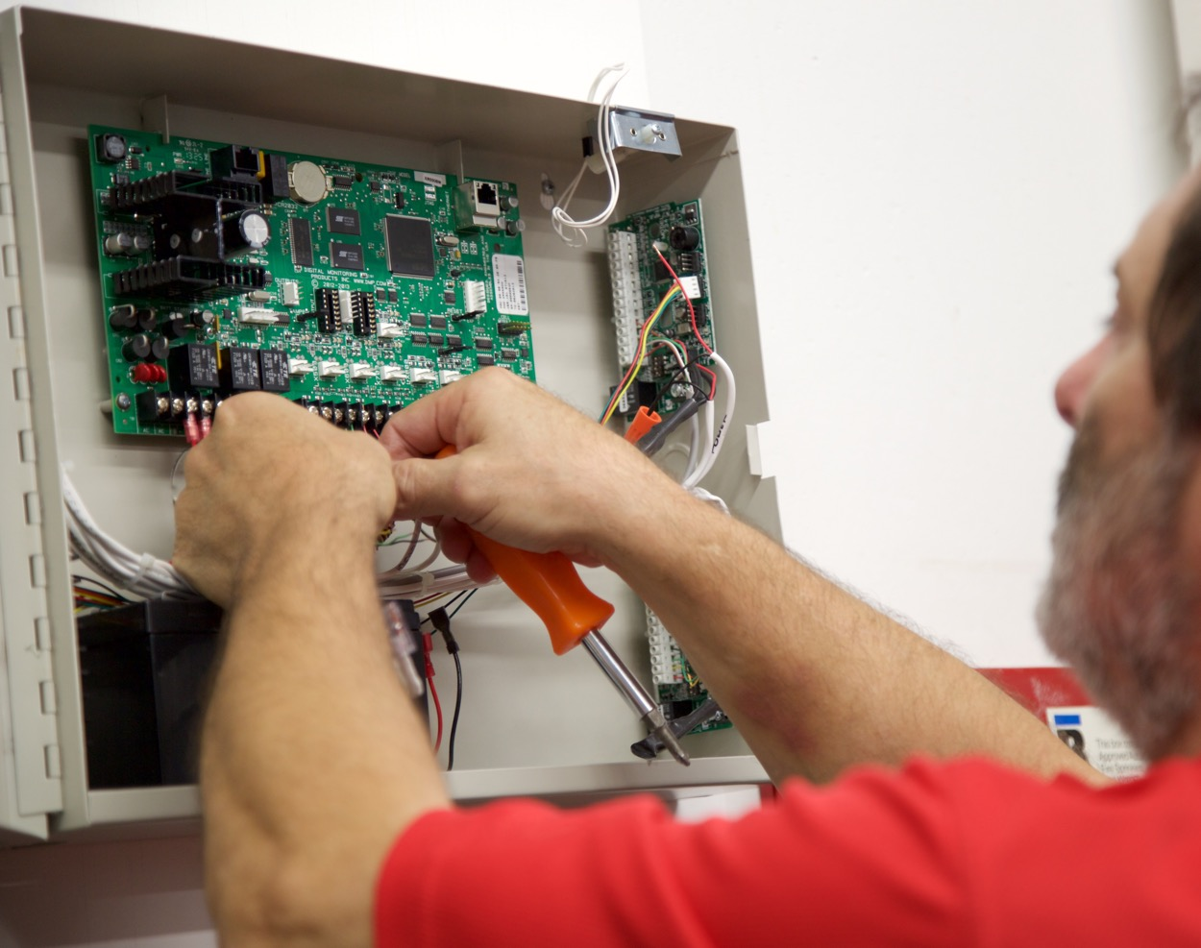
New Panel Features

Slide 20
XT Version 213 Panel Update
711S Module Programming Improvement — rather than using rotary switches, modules are now pre-programmable for faster installations simply by entering the 10-digit serial number in Zone Information
Improved Central Station Test Failure Procedure – no need to wait on the central station to receive failed-to-test notifications. Now you have everything you need, including the ability to run communication tests and identify which path isn’t working to offer customers proactive service
Active/Inactive User Code Capability – credentials can be deactivated so users on vacation can’t disarm the system or enter the premises
Scheduled Users – now all XT and XTL Series panels allow users to be tied to a specific schedule

Slide 21
XR Version 213 Panel Update
711S Module Programming Improvement — rather than using rotary switches, modules are now pre-programmable for faster installations simply by entering the 10-digit serial number in Zone Information
Improved Central Station Test Failure Procedure – no need to wait on the central station to receive failed-to-test notifications. Now you have everything you need, including the ability to run communication tests and identify which path isn’t working to offer customers proactive service
DHCP Enhancement — allows you to keep the panel set to DHCP but temporarily redirect it to overcome any DNS issues that may not be resolving

Slide 22
Com Series Universal Communicators
711S Module Programming Improvement — rather than using rotary switches, modules are now pre-programmable for faster installations simply by entering the 10-digit serial number in Zone Information
Improved Central Station Test Failure Procedure – no need to wait on the central station to receive failed-to-test notifications. Now you have everything you need, including the ability to run communication tests and identify which path isn’t working to offer customers proactive service
Active/Inactive User Code Capability – credentials can be deactivated so users on vacation can’t disarm the system or enter the premises
Scheduled Users – now all XT and XTL Series panels allow users to be tied to a specific schedule
Improved Network Retries for Central Station Communication — all stored messages are immediately sent as soon as network is reestablished

Slide 23
We’re here for you.
Notes:
DMP is committed to being a great partner for our dealers.

