Slide 1
Digital Monitoring Products
Notes:
DMP is a family-owned manufacturer of electronic burg/fire/access products. Since 1975 we have designed, built, distributed & supported those products from our headquarters in Springfield, MO. We sell directly to preferred alarm companies who are passionate about providing life-safety and peace-of-mind and focused on recurring monthly revenue. This is our only business.

Slide 2
Protecting the Largest Financial Institutions
in North America Since 1988

Slide 3
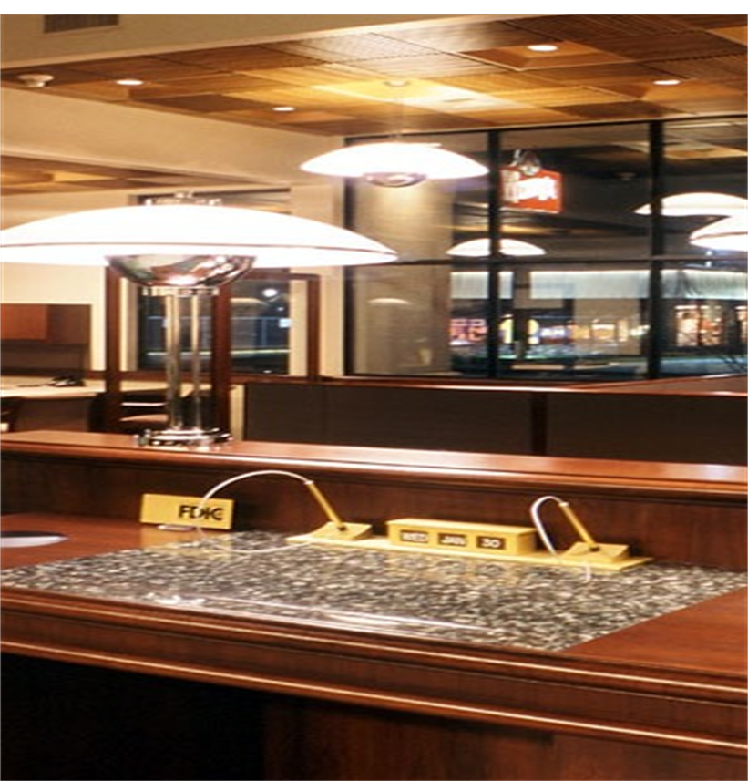
Integrated Product Advantages
The Standard for Bank Security
Customer and employee safety
Protecting assets
Information management
Audit compliance
Risk management

Slide 4
Why Banks Select DMP
More than 170,000 branches and remote ATMs protected
40 years of experience in network communication
DMP experience managing conversion projects since 1995
Open architecture for easy integrations
Easy replacement or upgrade of existing installed systems
Forward and backward compatible
Fully integrated intrusion, fire and access control
Advanced features unique to banks
Advanced audit compliance management software
Cost-effective 80-hour standby and disaster recovery power
Meets UL and ULC High Line Security standards

Slide 5
DMP
Integrated Solution

Slide 6
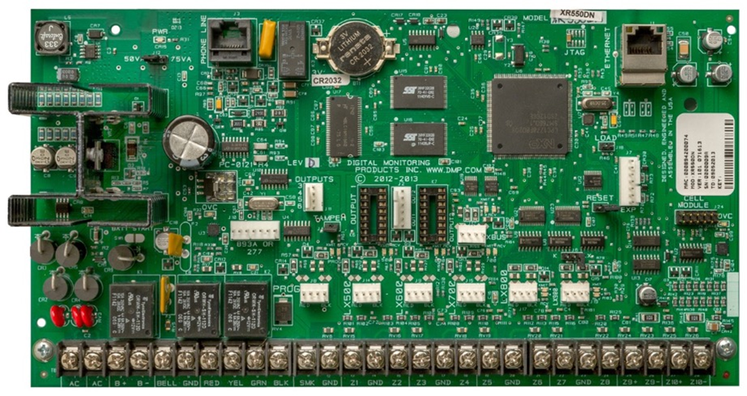
XR550 Control Panel
Base System
10 programmable zones onboard
Expandable to 574 wired zones
Up to 500 integrated DMP wireless zones
32 separate areas
Supports up to 16 supervised keypads
Includes 32 access doors (expandable to 96)
99 customizable user profiles
Network, dialer and IP cellular ports onboard
Eight communication paths using dial, net, cell or Wi-Fi
Configurable EOL for eight onboard intrusion zones

Slide 7
XR550 Control Panel
System Capacity
Network, Wi-Fi, wireless or hardwired access door controllers
Wireless or hardwired relay outputs
100 relay output schedules
12,000 event buffer
10,000 user codes or access credentials
Flash updatable (on-site or remotely)
Encryption 128 or 256 bit (option)
Selectable English, French or Spanish User Menu

Slide 8
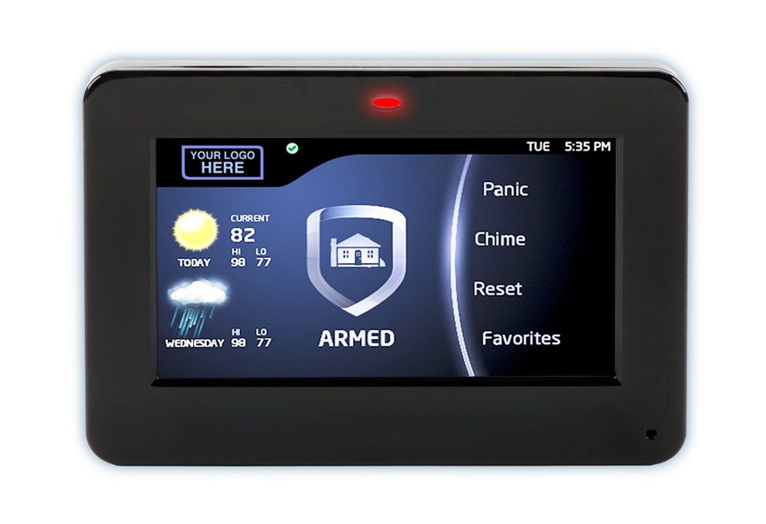
Touchscreen Keypad
Features
Built-in access control reader
Touchless arming and disarming
Hardwired or wireless
Up to 16 supervised
High security model with privacy screen and randomizing digits
Alarm and false alarm verification feature
Screen turns red when in alarm
Custom logo with help screen

Slide 9
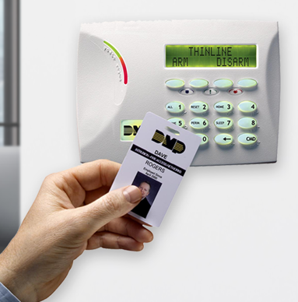
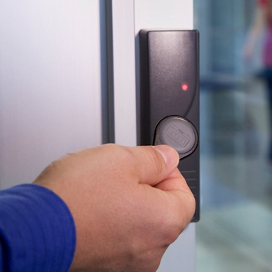
Integrated Keyless Access – Go Touchless
Security and Access Management
Customized reporting for quick review of all access and user activity
Create detailed user access rights by profile and schedule (with permission to enter only certain areas at programmable times)
Active directory interface (Instantly allow or terminate all access privileges)
Expand access to teller line, server room, drive-up kiosk or ATM vestibule
Hands-free disarming and arming from DMP keypad or reader
Manage branch service providers (couriers, cleaners, ATM services)
Auto rearm delay schedules for cleaners, couriers and ATM service
Audit credentials that aren’t being used

Slide 10
DMP IP Based Cellular Communication

Slide 11
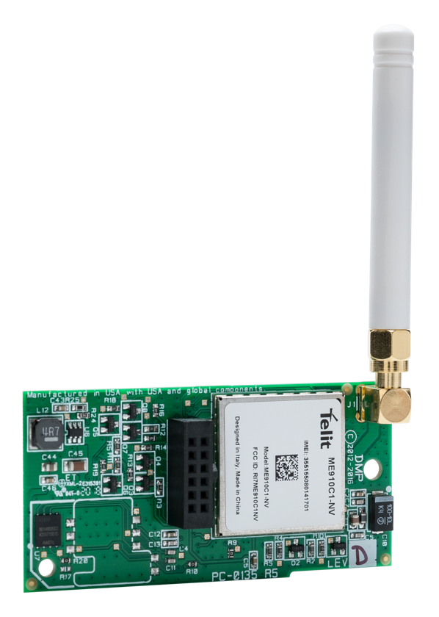
Digital Cellular Communications
DMP’s Digital Cellular Communicator
Remote programming and connection over cellular
LTE cellular services with AT&T and Verizon
Direct IP to IP communication to DMP receiver
Programmable as stand alone, primary or backup with UL compliance
No intermediary server
Private VPN option
DMP exclusive Adaptive Technology™
Supports 128- or 256-bit encryption
Connected to and powered from the XR550 control panel
No additional hardware required
Messages received within three to five seconds globally
Programmable supervision or check-in
UL High Security Listed as stand-alone communication device

Slide 12
DMP Smart
Two-Way Wireless™

Slide 13
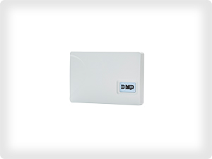
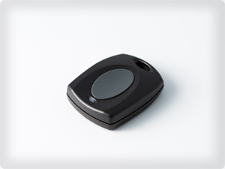
900 MHz Frequency-Hopping Communication
Two-Way supervised communication between transmitters and receiver
Selectable supervision time
3, 60 and 240 minutes
Superior battery life and range
Smart motion detectors with Disarm/Disable feature
Activate motion detector Wireless Test at DMP keypad
With summary reporting to automation
128-bit encryption option
Activate test of holdup devices and zones at the branch keypad
With summary reporting to automation
Portable duress transmitters for staff safety and security
Access credential option
Programmable jamming detection and reporting

Slide 14
DMP User and
System Management Software

Slide 15
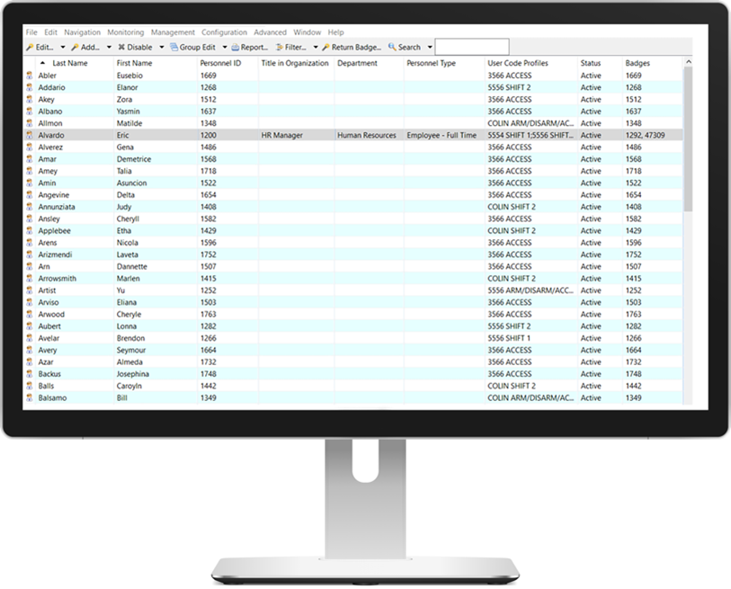
A single unified system to manage one badge, one face or one user worldwide

Slide 16
Security Access Features
Remote panel programming – a single interface to upload, download, change users, schedules and profiles across the entire enterprise of XR150 or XR550 panels
256-bit encryption from end to end keeps data secure
Copy panel programming from one to multiple XR Series panels
Video integration for live image capture of selectable events
Track open and close exceptions, as well as Late-to-Open and Early-to-Close events
Search all XR panels for activity by user’s name, employee number, profile, department or service provider user code for all activity
Wireless DMP key fob programming and tracking by user’s name
Customized and automatic reports via email to regional security managers
Invalid code or access credential information capture — Entré will display the code used or embedded access credential code
Selectable operator language (English, French or Spanish)
Exception tracking and reporting of inactive users and inactive zones

Slide 17
XR550 – Advanced Bank Features
Early Morning Ambush
If selected, when an associate enters his/her code at the keypad upon opening, a timer (1-15 minutes) will begin. Anytime during that timer and branch inspection the associate must enter the code a second time to stop the timer. If the timer expires, an Early Morning Ambush message will be sent to the monitoring center with the user ID and location.
Benefit: Employee Safety & Audit Compliance
Inactive User Audit
A user’s code not used in a programmable number of days will cause an Inactive User Code message with the user’s name and ID number. This is programmable from 1 - 425 days.
Benefit: Enhanced Security & Audit Compliance
Temporary User Codes
Can be programmed with start date and time, as well as end date and time.
Benefit: Audit Compliance & Security
Technician Disarming Restriction
Service technician may not disarm selected areas which were last armed by a bank associate.
Benefit: Enhanced Security
Dual Authority (XR550 with network or encryption only)
Requires two user codes to be entered at the system keypad to disarm and/or arm the selected area(s). After the first code is entered the keypad will display “2ND CODE.” Both codes must be of equal authority or higher.
Benefit: Eliminate Log & Audit Compliance

Slide 18
XR550 – Advanced Bank Features
Panic Test
Allows the panic zone test verification or failure results to be sent to the monitoring center receiver. The system test start, stop, panic zone verification and panic zone failure messages are sent.
Benefit: System integrity, audit compliance
Inactive Zone Auditing (Selectable by zone)
Over a programmable period of time, the XR550 monitors selected zones for activity in the armed or disarmed state. If a zone does not change status over the selected number of days, a message is transmitted stating the inactive zone name, number and system number.
Benefit: System integrity & Audit Compliance
False Alarm Question
This option allows the user to investigate a burglary alarm prior to disarming the system and send an “Alarm Verified” or “Alarm Cancelled” message to the monitoring center. The keypad with display “IS THIS A FALSE ALARM? NO OR YES” when the alarm occurs. Selecting NO will transmit the alarm as VERIFIED to the monitoring center with the user’s name. Selecting YES sends an ALARM CANCEL message with the user’s name.
Benefit: Reduce False Alarms & Police Dispatch
Late To Open
If a branch has not opened within a selectable number of minutes after the scheduled opening time, a “Late-to-Open” message is transmitted to the monitoring center. Selectable for 1 – 240 minutes.
Benefit: Employee Accountability & Audit Compliance
Early To Close
As above, in the event a branch is armed prior to the scheduled closing time, an “Early-to-Close” message is transmitted to the monitoring center. Selectable for 1 – 240 minutes.
Benefit: Employee Accountability & Audit Compliance

Slide 19
XR550 – Advanced Bank Features
Enhanced Zone Test
Select Yes to allow enhanced zone test operation for Wireless Test. This will allow testing of all panic and burglary zones by the associate or integrator. At the end of the test a summary message will be sent to the DMP receiver identifying all zones which were tested, zones which were not tested, as well as the user’s name and number who performed the test at that location. Benefit: System Integrity & Audit Compliance
Card + PIN (network or encryption only)
Card + PIN requires users to present both a credential and enter a pin number before a selected area can be disarmed.
Benefit: Enhanced Security & Audit Compliance
Priority Zone
Selected zones in this area must be in the normal condition before the area can be armed. Benefit: Enhanced Security
Portable Panic Supervision
The 1144-1P-PSV Wireless Panic Key Fob is designed to be used by regional employees working across multiple sites, which are supervised at a single monitoring center using the SCS-VR Virtual Receiver. The serial number of each employee’s fob is programmed into the panel at each work site they’ll visit. When a fob syncs with a location’s wireless receiver, that panel sends a check-in message to the monitoring center, identifying the location and employee. By sending the check-in message, the fob also confirms it’s working as expected. Benefit: Audit Compliance, Employee Safety
Video – XR550 Zone Integration
Allows cameras to be assigned to specific zones on the XR550. Example #1: If a camera is assigned to a teller location with zone 500 holdup and the teller activates the holdup, the camera is triggered to record and the monitoring center is notified by the panel alarm along with the video clip to view for verification. Example #2: During armed times, if an intruder activates a motion detector programmed to zone 2, the camera in that area will record and zone 2 in the XR550 will immediately send an alarm to the monitoring center at the same time the recording arrives.

Slide 20
Questions

Slide 21
Thank You

